Slide 1
Optiver
22nd of February 2011
Guest lecture Prime

Slide 2
Introduction
Maarten Jacobs
Background
- Business Studies at K.U. Leuven, Belgium - Master in Financial Management at Vlerick Management School - Bachelor in Mathematics at K.U. Leuven.
Started in 2009 at Optiver as Arbitrage Trader - Before, I worked with KPMG and ING Financial Markets

Slide 3
Content
About Optiver
Our culture
Our trading philosophy
Careers

Slide 4
About Optiver
International proprietary trading firm *Market Maker on many exchanges *No clients
600 employees worldwide
Europe, North America and Asia Pacific as our domain
More than 20 years experience in the business

Slide 5
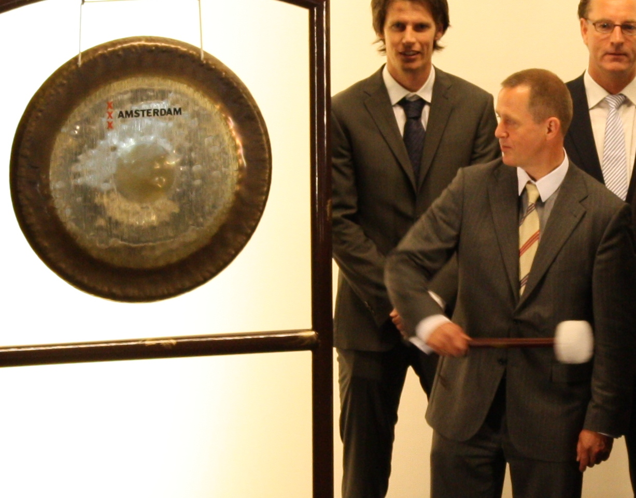
1986:
Johann Kaemingk began a trading firm

Slide 6
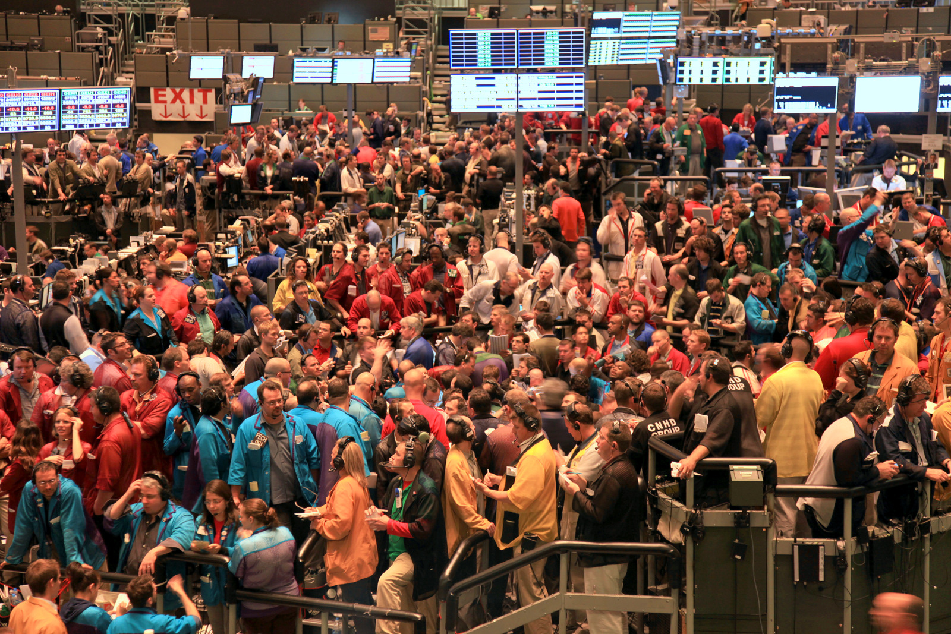

Slide 7
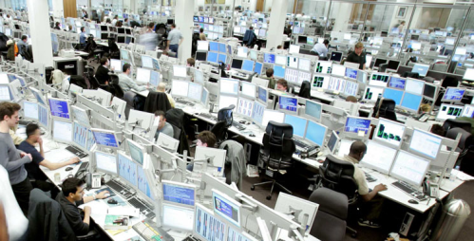
2001: Euronext Amsterdam 100% Screen Trading
Notes:
Euronext Amsterdam
100% screen trading

Slide 8
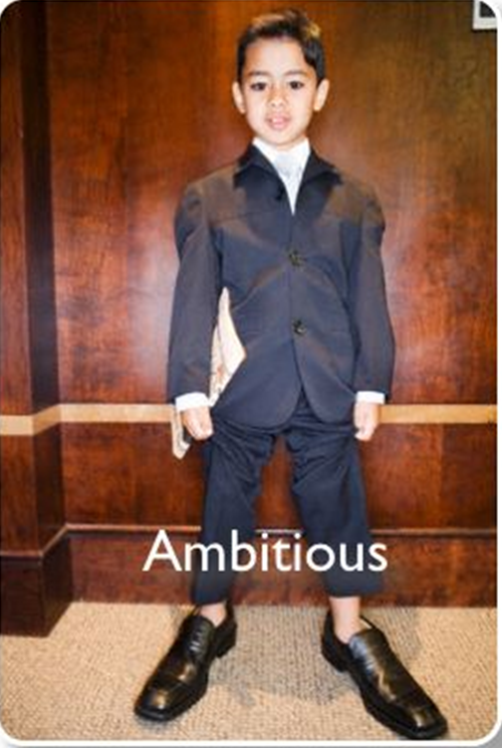
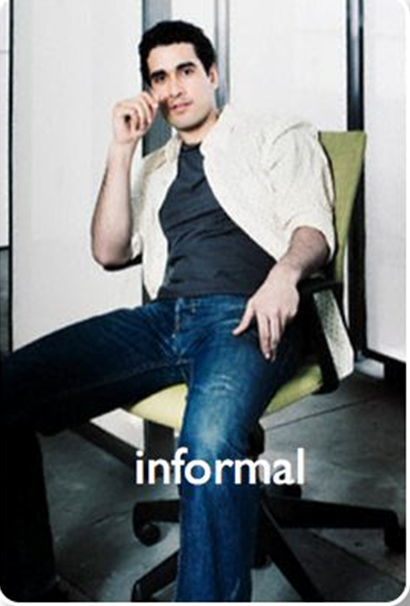
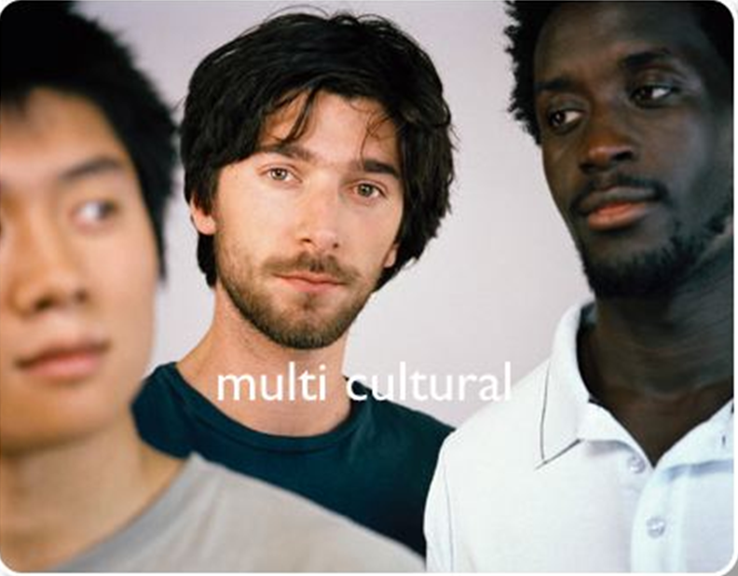
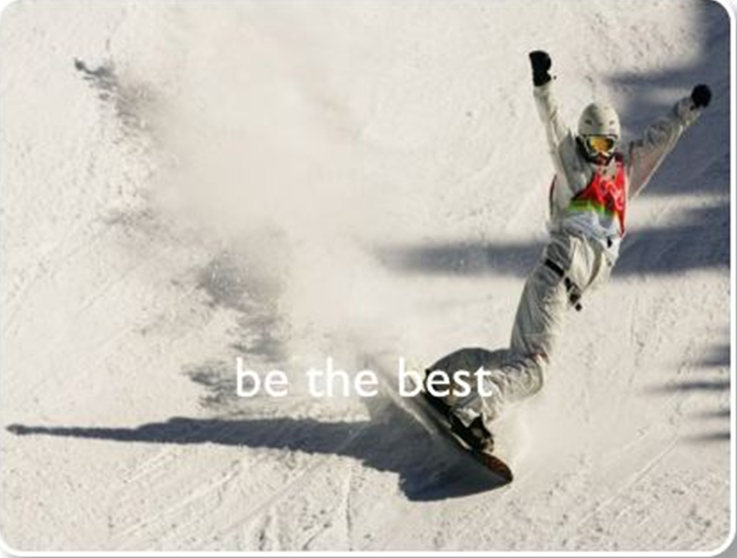
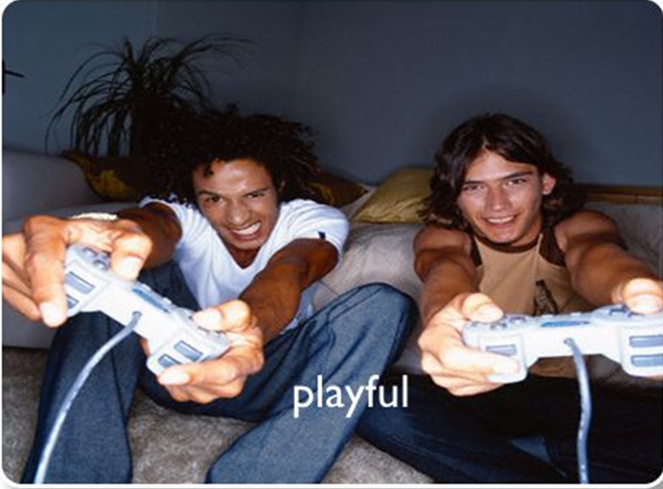
Optiver Culture
Notes:
We remain strongly results-driven, which has contributed significantly to our rapid growth.
Multi-cultural
Strive to be the best at whatever we do
Open communication and teamwork
Foster an environment of creativity
Multi cultural, be the best, informal, ambitious, playful but reliable
There is no “good enough” only the potential to do better = winners mentality
Value is placed in a “winners mentality”, a dedication to success and a commitment to excellence
We strive to be the best at what we do. We don’t just aim to surpass our competitors. We also work to exceed our previous achievements.
We acknowledge the importance of open communication and teamwork. We believe that no single person is as valuable as the collective strength of the entire team.
We support an environment of continuous improvement. To us, there is no ‘good enough’ – there is only the potential to do better.
We foster an environment of creativity. We believe our next achievement will begin with the creative thinking of one of our employees.
We recognise that our success depends upon our position of profit. Our financial success will fuel our professional and personal development.
We do not place value in manner of dress, country of origin, religious affiliation or other demographic identifiers. Instead, we place value in a ‘winner’s mentality’, a dedication to success and a commitment to excellence.

Slide 9
Trading Industry Overview
Multiple types of industry participants
Individual investors
Banks
Investment funds
Hedge funds
Pension funds
Mutual funds
Broker dealers
Proprietary trading firms

Slide 10
Core Business
Trading in the wholesale market (In-direct)
Brokers
Optiver
Wholesale
Traders
Optiver
Screen
traders
Screen
trading
Exchange
Screen
trading
Counterparties
Notes:
Wholesale trading is the area where we trade anything that is not traded directly via the screen (listed products only). In general this is done in a size that is blockable, depending on the product usually 500 or more lots.

Slide 11
Trading
Options
Equity
Index
Cash
Equity
Index
Wholesale
Large counterparties
Fixed Income
Interest rate
Currency
Commodity
Currency
Notes:
We trade electronically from our offices on the exchanges, but what do we trade?
Option trading We trade equity, index, fixed income, interest rate, currency and commodity options
Cash trading We also trade cash: equities, indices and currencies
Wholesale trading We trade options directly with large counterparties, over the phone

Slide 12
The basic idea I
Market Making: show a bid and an offer - Provide liquidity
What we don’t do: take directional positions, like pension funds or asset managers
Optiver is a TRADING company

Slide 13
The basic idea II
We make money by buying and selling the same product
Spread is the difference between buying (bid) and selling (offer) price
Summary of our business:
Revenue = Realized Spread * Volume

Slide 14
Market Maker
Bid price: For this price the Market Maker is willing to buy
Ask/Offer price: For this price the Market Maker is willing to sell
Quote = A bid and an offer
Notes:
In a quote drive market the bid and ask prices determine the limits in which the rates are developing.
Traders buy at their bid prices and sell at their ask prices on their own account on their own risk.

Slide 15
Market Maker view
Market Maker quotes:
Bid - Offer
10 - 15
Market Maker buys @ 10 or sells @ 15.
Notes:
In a quote drive market the bid and ask prices determine the limits in which the rates are developing.
Traders buy at their bid prices and sell at their ask prices on their own account on their own risk.

Slide 16
Client view
Market Maker quotes:
Bid - Offer
10 - 15
Client buys @ 15 or sells @ 10.
Notes:
In a quote drive market the bid and ask prices determine the limits in which the rates are developing.
Traders buy at their bid prices and sell at their ask prices on their own account on their own risk.

Slide 17
What will be the next market?
Client 1 buys @ 15
Next market from MM will be : 12,5 bid at 17,5 offer
Client 2 sells @ 12,5
Next Market from MM will be: 10 bid at 15 offer
Profit?
Notes:
In a quote drive market the bid and ask prices determine the limits in which the rates are developing.
Traders buy at their bid prices and sell at their ask prices on their own account on their own risk.

Slide 18
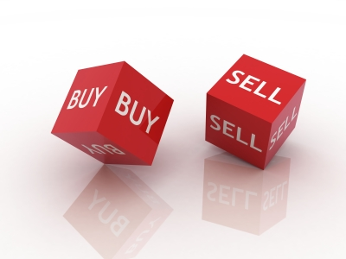
Make your Market

Slide 19
How to make a market of beer?

Slide 20
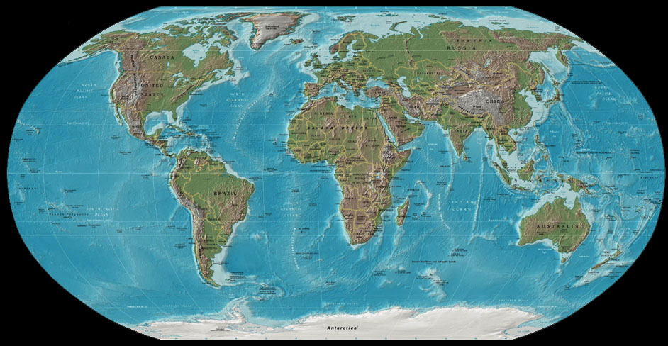
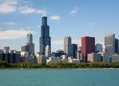
Distance from Amsterdam to Chicago?
Notes:
6606 km

Slide 21
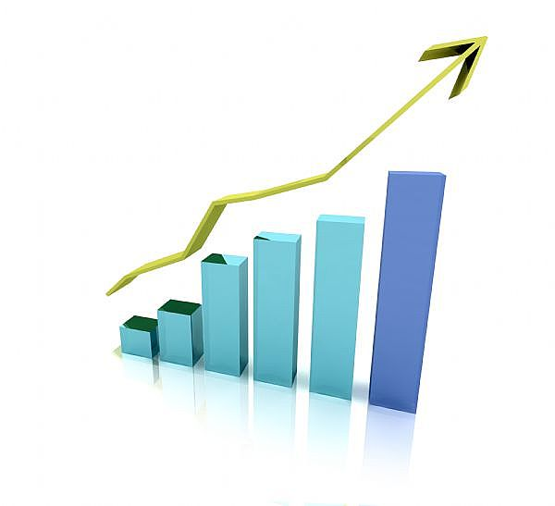
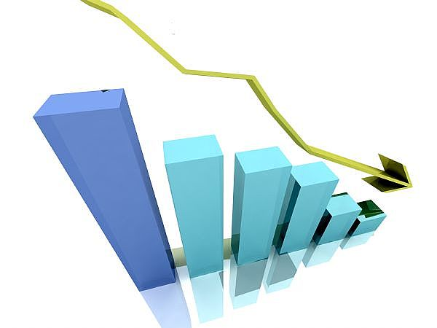
Calls & Puts
Call Put
Notes:
A call-option gives the right to buy the underlying value for a certain price at a certain time
A put-option gives the right to sell the underlying value for a certain price at a certain moment

Slide 22
Influence on option price
 | Call | Put
Underlying (S) ↑
Strike (X) ↑
Time to expiration (t) ↑
Interest (r) ↑
Dividend (d) ↑
Volatility (σ) ↑
Notes:
Time value (Expectation value)
Volatility
Price underlying Share
Expiration
Call = Put !

Slide 23
Options
This is how options are priced
Expected gains of underlying value are estimated
…and corrected for:
Costs (interest)
Possible pay-outs (dividend)
After determination of price, quote in the market!
Notes:
In the money (ITM):
Price underlying > exercise price
At the money (ATM): Price underlying ≅ exercise price
Out of the money (OTM):
Price underlying < exercise price

Slide 24
Wholesale Trading: Daily tasks
Trading over the phone (3000 markets per day!)
Maintain key international indirect relationships
Representing Optiver’s order flow
Establishing new direct trading relationships
Notes:
Wholesale trading in its current form is the link between the traders within Optiver and the counterparties that choose to trade over the phone/box (professional market) instead of through the screen. Often these counterparties communicate with us through brokers. We are also increasingly focusing and successful in getting direct parties to trade with us.
Why do we trade the prof market?
Liquidity, we can use the prof to hedge our positions.
Information, even if we do not trade, the fact that something is trading provides us with very useful information.
Profitability, by gaining access to these larger markets we can actually make more money.
Necessity, usually the prof market is leading the screen and we can’t afford ourselves not to know what is going on in it without risking to lose money on the screen.
The current main tasks for wholesale traders are:
Screen information and use this information to facilitate trading
Make markets and keep markets up to date
Actively looking for trading opportunities in the market
Initiate markets
Maintain relationships with in- and external counterparties
Ensure that Optiver is the number 1 on the call list of counterparties
Establish new trading relationships
Represent Optiver to the external counterparties
Be the “eyes” and “ears” of the company
Help to grow the company

Slide 25
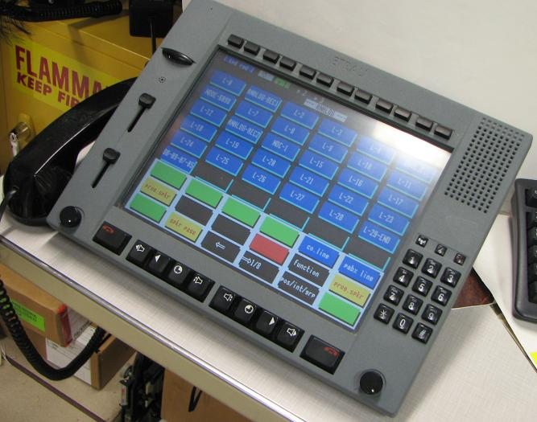
The dealing board
Trading over the phone
3000 markets per day
Direct contact with a push of a button

Slide 26
Wholesale Trading: Characteristics
Excellent Communication skills
Sales and entrepreneurial skills
Extrovert
Interpret data quickly
Fast and accurate decisions
Excellent social skills
Notes:
Excellent social and communication skills
Ability to interpret data quickly
Make fast and accurate decisions
Extrovert, easy to approach
Sales skills
Social skills

Slide 27
Trading: Daily tasks
Providing bids and offers to the option market
Providing liquidity to the markets
Use our pricing models
Continuous trading
Notes:
Our role has traditionally been to provide bids and offers to the options market. When you phone your broker to place an order to buy or sell an option, the majority of the time it’ll be a market maker on the other side providing you the price.
What we do is called arbitraging, so market direction doesn’t interest us. Our job is to provide liquidity to the market, so it’s actually you, the investor, who makes the trading decisions and we just provide a price for the options, that you want to trade.
We use our pricing models to determine relationships between these options and we’ll then make a price for one based upon prices in the others. Everything is done in seconds or fractions of a second.

Slide 28
Screen Trading: Characteristics
Work under high presuure
Responsible and integrity
Affinity financial markets
Excellent numerical and analytical skills
Competitive attitude
Notes:
We remain strongly results-driven, which has contributed significantly to our rapid growth.
Multi-cultural
Strive to be the best at whatever we do
Open communication and teamwork
Foster an environment of creativity
There is no “good enough” only the potential to do better = winners mentality
Value is placed in a “winners mentality”, a dedication to success and a commitment to excellence
We strive to be the best at what we do. We don’t just aim to surpass our competitors. We also work to exceed our previous achievements.
We acknowledge the importance of open communication and teamwork. We believe that no single person is as valuable as the collective strength of the entire team.
We support an environment of continuous improvement. To us, there is no ‘good enough’ – there is only the potential to do better.
We foster an environment of creativity. We believe our next achievement will begin with the creative thinking of one of our employees.
We recognise that our success depends upon our position of profit. Our financial success will fuel our professional and personal development.
We do not place value in manner of dress, country of origin, religious affiliation or other demographic identifiers. Instead, we place value in a ‘winner’s mentality’, a dedication to success and a commitment to excellence.

Slide 29
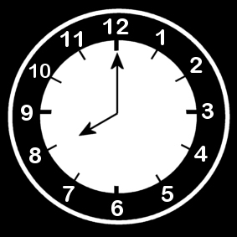
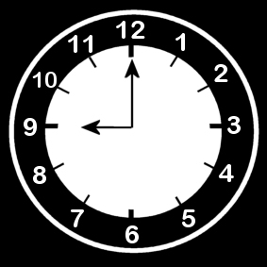
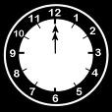
Trading Day
8 o’clock: Start up the screens, breakfast, check positions, check the news, make an estimation of what is going to happen (figures).
Be sharp at 9 o’clock, exchange is open, Trading Starts!
Put quotes in, make markets for the brokers, trade, buy, sell, hedge, scalp, hack, adjust prices!
Between 12:00 and 14:00, get some lunch when it’s quiet.

Slide 30
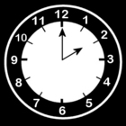
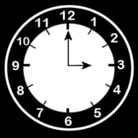
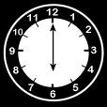
Trading Day
Get a chair massage, check email, make bets with colleagues and discuss positions.
14:30 Figures!
15:30 America opens and it becomes busy!
Towards the close, check risk limits and close out positions.
18:00 Closed, administration, turn off screens GO HOME!

Slide 31
Questions??

Slide 32
Careers at Optiver
Good salary and benefits
Three months intensive training
Continuous on the job development
No simulation only real trading
Regular working hours, no weekend work

Slide 33
Application Procedure
1st Step: Technical Test
2ndStep: Interviews
3rd step: Offer
This can be done in just a few days.
For more information, look at www.optiver.com
Or contact recruitment +31 (0) 20 708 70 00.
Kim Ruijer (Recruiter Trading)

Slide 34
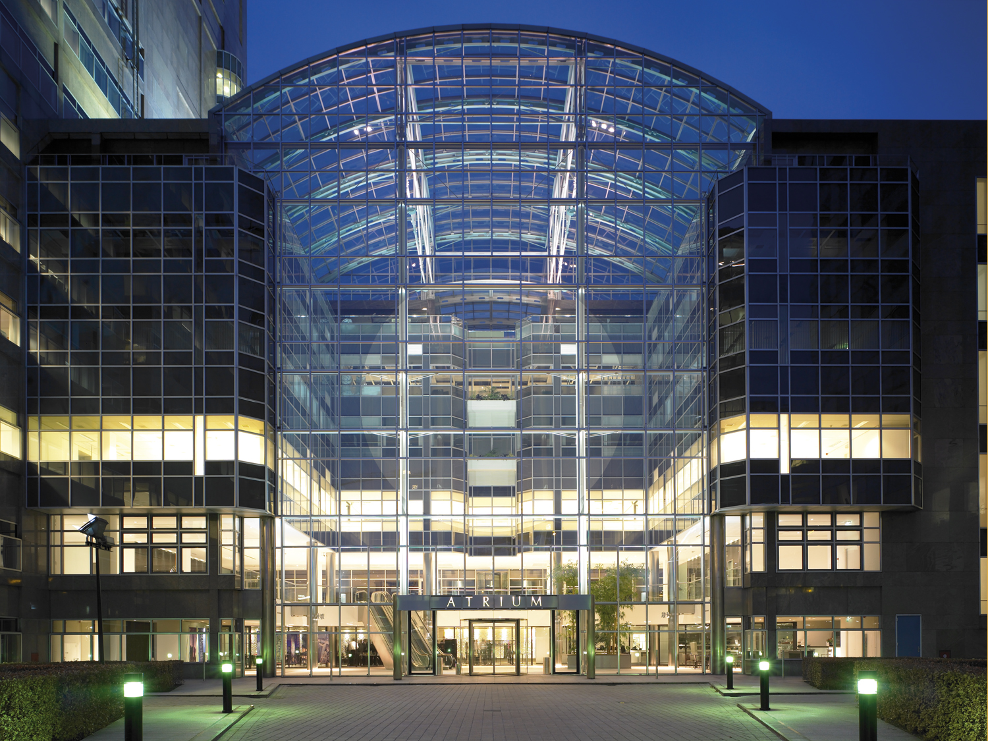
Thank you for your attention!

